Slide 2
Bauman’s “space of flows”
a type of space “where global powers reside and operate,” and in which "it is the speed of movement and facility to escape, not the size of territorial possessions (and so responsibilities), that count and decide.… New empires are not of this world—not of earthly, geographical world, not of the ‘space of places.’ (112)

Slide 3
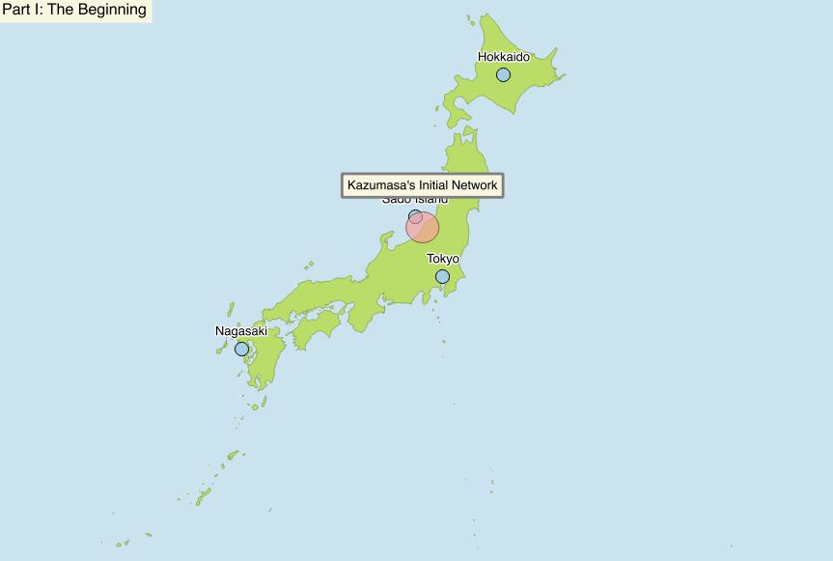
Kazumasa’s humble beginning

Slide 4
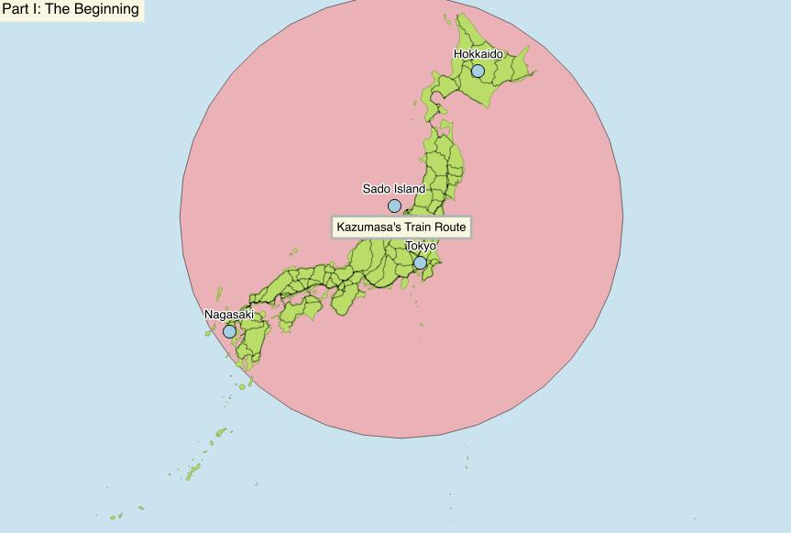
Kazumasa enters circulation

Slide 5
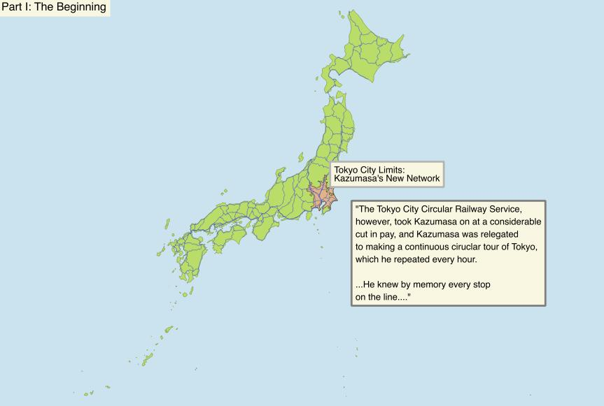
Kazumasa’s network diminishes

Slide 6
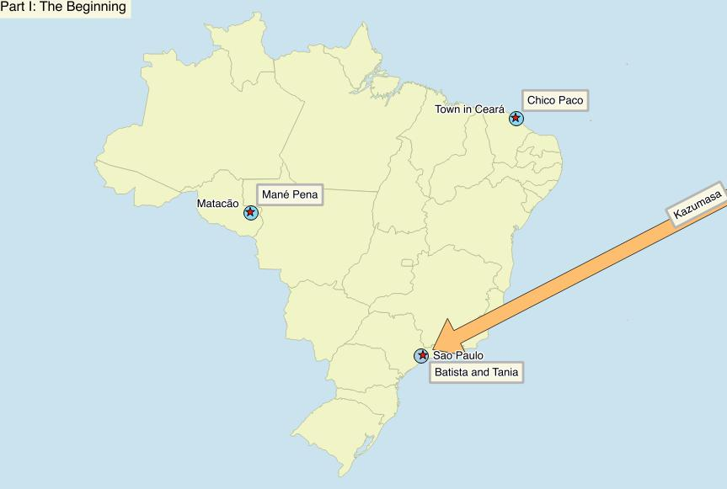
Kazumasa goes to São Paulo

Slide 7
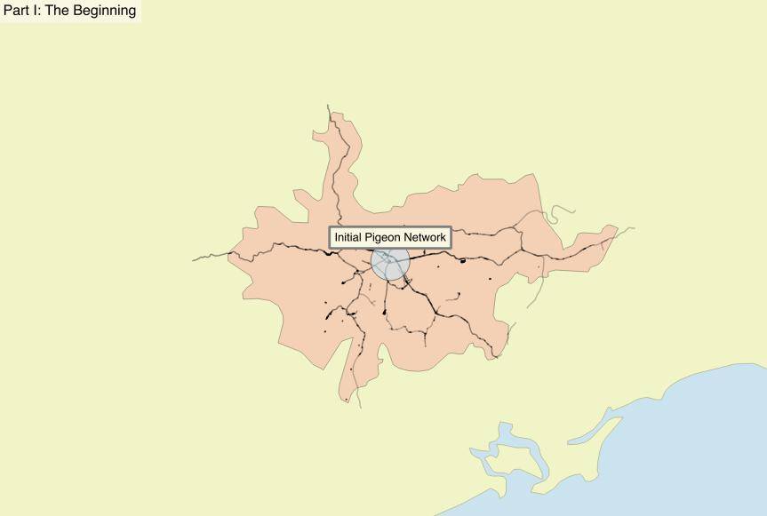
Batista and Tania Aparecida Djapan’s pigeon network

Slide 8
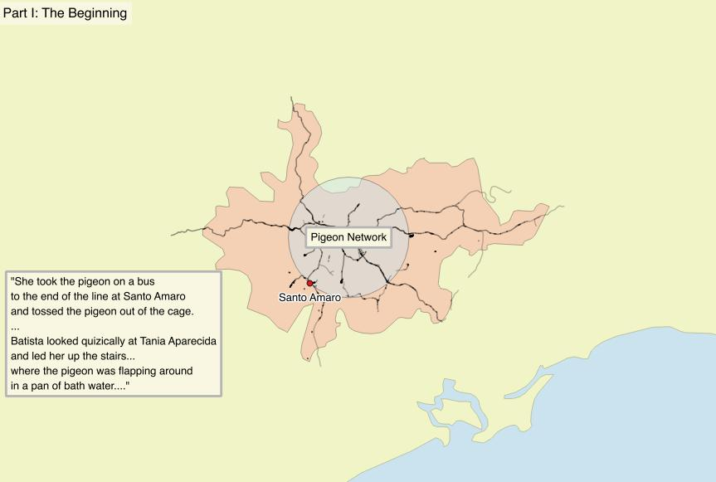
A single pigeon increases the scale

Slide 9
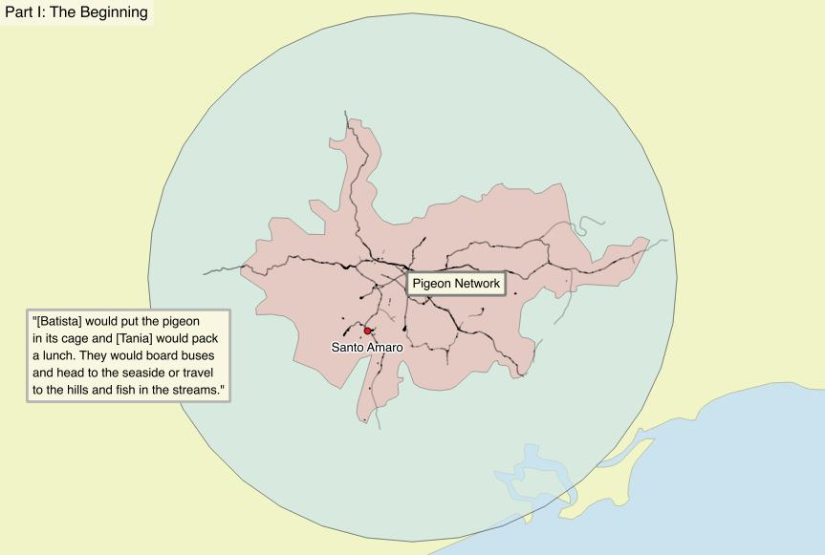
Pigeon network exceeds São Paulo

Slide 10
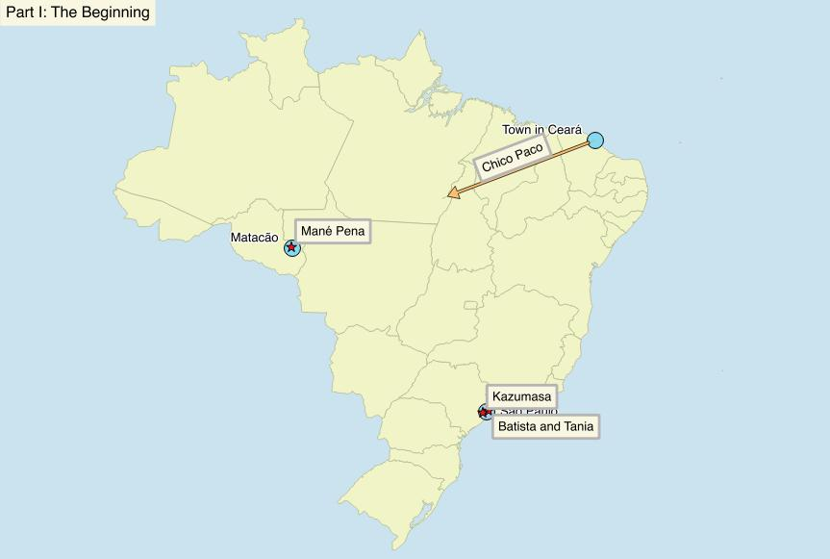
Chico Paco’s first pilgrimage

Slide 11
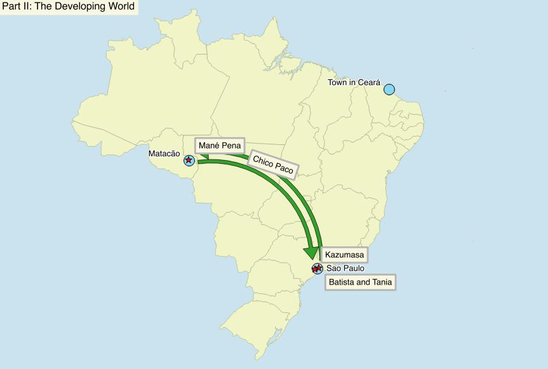
Trip becomes circuit

Slide 12
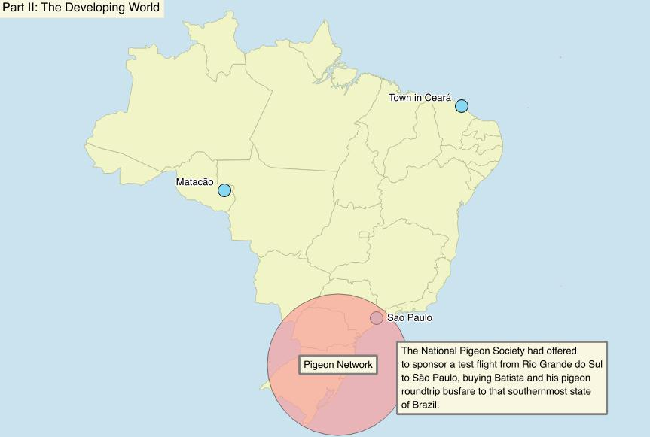
Pigeon Networks cover a whole region, get funding

Slide 13
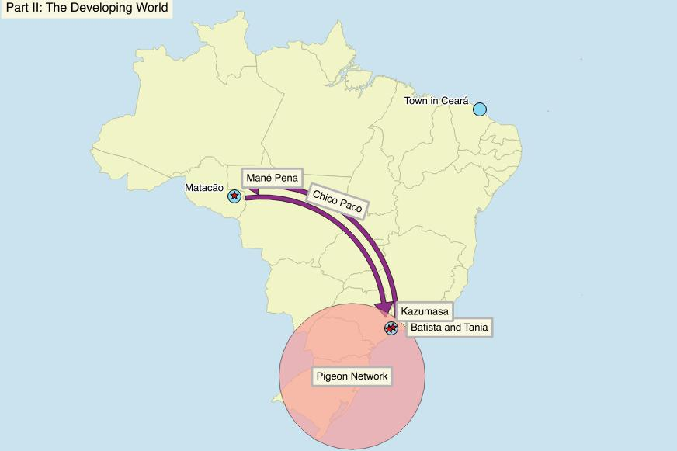
All networks as of Part II

Slide 14
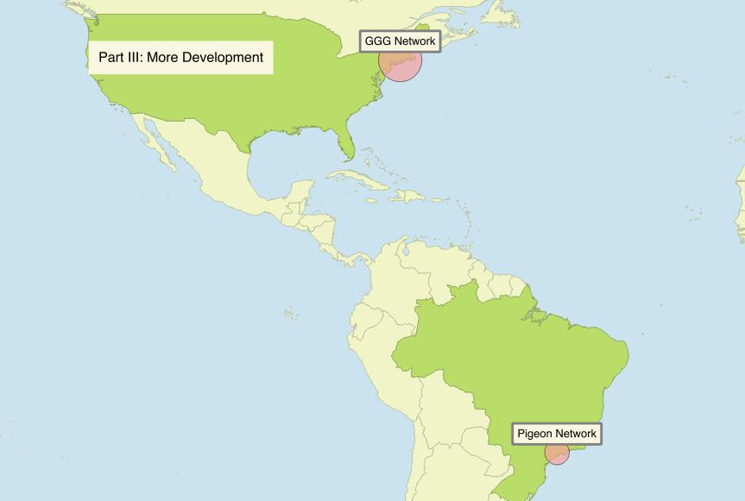
Global networks, Part I - Part III: before

Slide 15
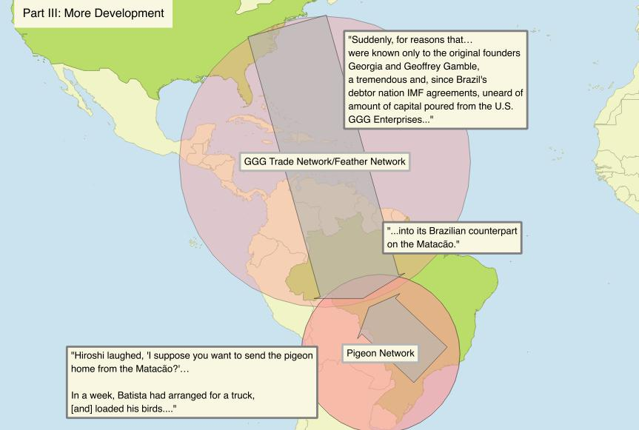
Global networks, Part I - Part III: after

Slide 16
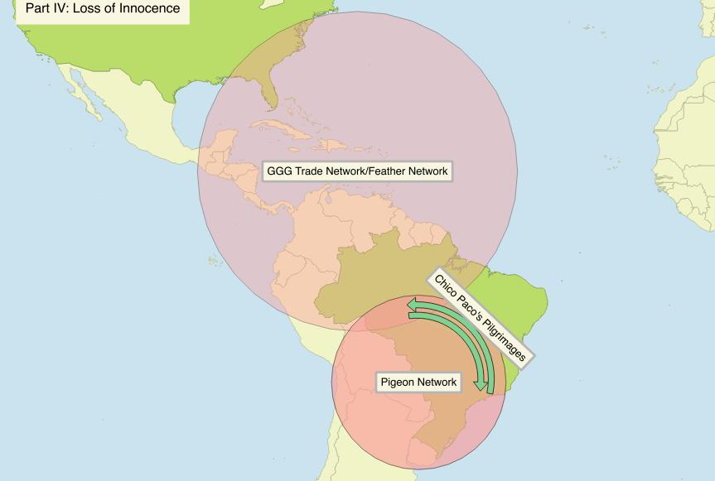
Pigeon network and pilgrim network combine

Slide 17
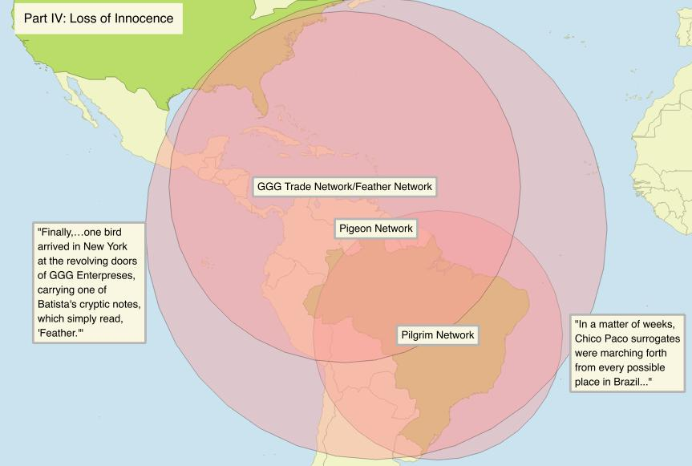
Networks go international

Slide 18
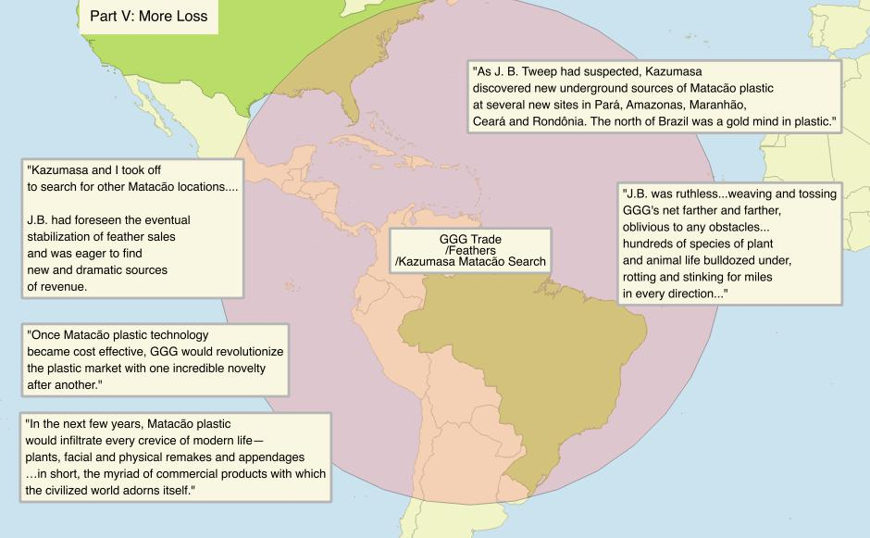
Centralization

Slide 19
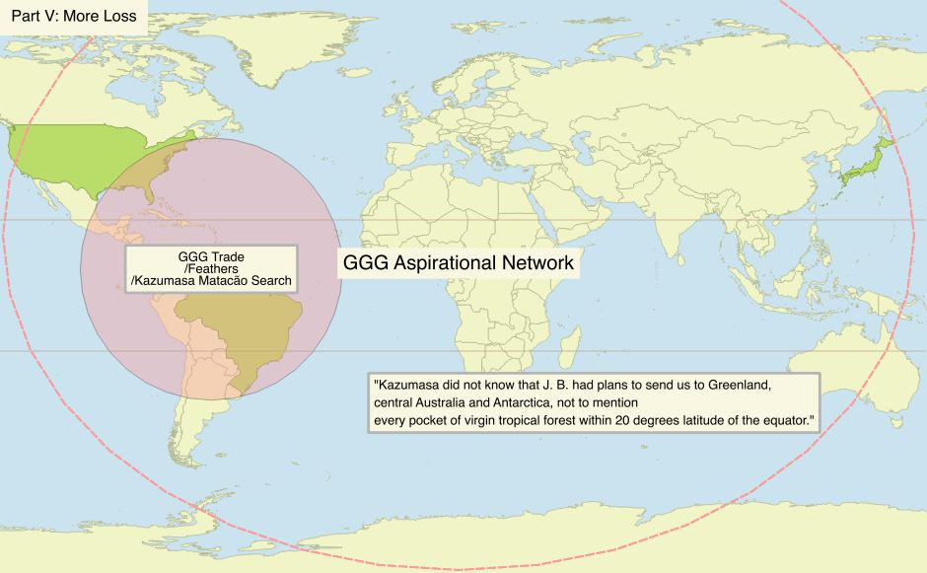
GGG’s global aspirations

Slide 20
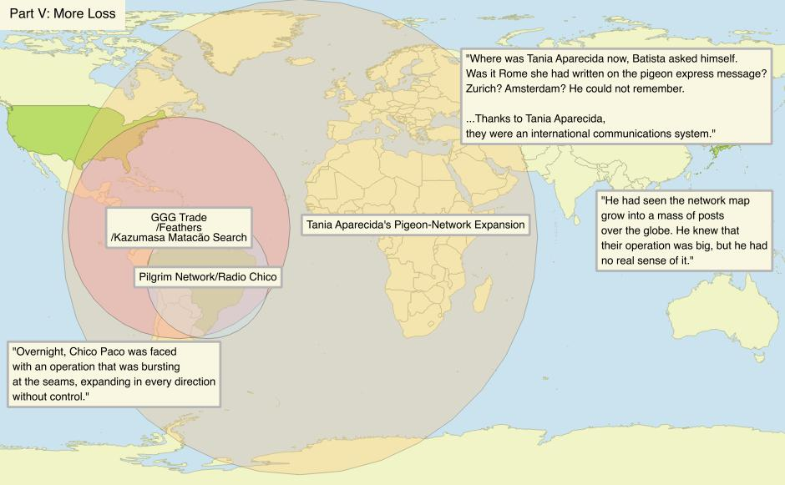
Pigeon network crosses the Atlantic

